Slide 1
Real Time Monitoring with Power BI

Slide 2

About You
Data centric or at least data adjacent role
Ask or have been asked
WHAT HAPPENED?
WHEN DID THIS HAPPEN?
https://www.flickr.com/photos/britishlibrary/11289228893/in/album-72157638906393085/

Slide 3

About Me
Bill Fellows
Principal Consultant Sterling Data Consulting
Microsoft Data Platform MVP 2014 – 2019
Loves SSIS, TSQL, Python, problem solving
Here to help
Bill.fellows@sterlingdataconsulting.com
816.200.7682
https://www.flickr.com/photos/britishlibrary/11288301815/in/album-72157638906393085/

Slide 4
Outline
Identify Issue
Capture Criteria
Establish Endpoint
Dashboard Design
Stream
Issue
Criteria
Endpoint
Dashboard
Stream

Slide 5

Problem Domain
What does “real time” mean
Is it really real time? Really really?
Data generation frequency
Pump up the volume
https://www.flickr.com/photos/britishlibrary/11287749756/in/album-72157638906393085/
Issue
Criteria
Endpoint
Dashboard
Stream
Notes:
Speed of your car, credit card transaction processing, dynamic pricing, sensor readings, texting, maps
Quantify things. Frequency of data being generated? How many data points in a generation?

Slide 6

Criteria
What metrics matter?
https://www.flickr.com/photos/britishlibrary/11303067153/in/album-72157638906393085/
Issue
Criteria
Endpoint
Dashboard
Stream
Notes:
Speed of your car, credit card transaction processing, dynamic pricing, sensor readings
Quantify things. Frequency of data being generated? How many data points in a generation?

Slide 7

Establish Endpoint
Define the shape
Primitive types: string, datetime, floating points
https://www.flickr.com/photos/britishlibrary/11304246774/in/album-72157638906393085/
Issue
Criteria
Endpoint
Dashboard
Stream
Notes:
Speed of your car, credit card transaction processing, dynamic pricing, sensor readings
Quantify things. Frequency of data being generated? How many data points in a generation?

Slide 8
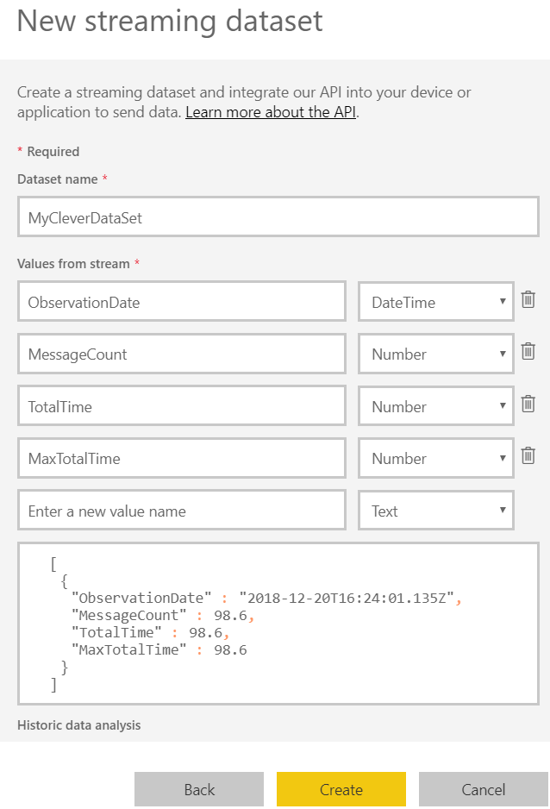
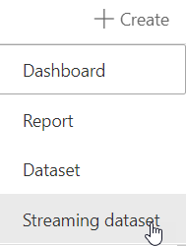
Establish Endpoint
Issue
Criteria
Endpoint
Dashboard
Stream
Notes:
Speed of your car, credit card transaction processing, dynamic pricing, sensor readings
Quantify things. Frequency of data being generated? How many data points in a generation?

Slide 9
Dashboard Design
You get what you get and you don’t pitch a fit
https://www.flickr.com/photos/britishlibrary/11303067153/in/album-72157638906393085/
Issue
Criteria
Endpoint
Dashboard
Stream
Notes:
I hope you like what you get because that’s it

Slide 10

Stream
No incantations required
But possibly considered helpful
https://www.flickr.com/photos/britishlibrary/11303446793/in/album-72157638906393085/
Issue
Criteria
Endpoint
Dashboard
Stream
Notes:
Sample code provided, ish, when you establish the endpoint

Slide 12


https://www.flickr.com/photos/britishlibrary/11302069825/in/album-72157638906393085/
https://www.flickr.com/photos/britishlibrary/11169538475/in/album-72157638906393085/

Slide 13


https://www.flickr.com/photos/britishlibrary/11130437034/in/album-72157638906393085/
https://www.flickr.com/photos/britishlibrary/11144964175/in/album-72157638906393085/

Slide 14

https://www.flickr.com/photos/britishlibrary/11142674924/in/album-72157638906393085/

Slide 15
Issue
Criteria
Endpoint
Dashboard
Stream
Issue
Criteria
Endpoint
Dashboard
Stream
Issue
Criteria
Endpoint
Dashboard
Stream
Issue
Criteria
Endpoint
Dashboard
Stream
Issue
Criteria
Endpoint
Dashboard
Stream
Issue
Criteria
Endpoint
Dashboard
Stream

